Slide 1
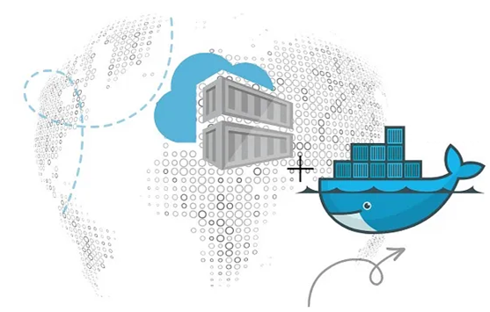
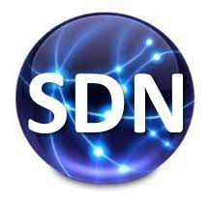
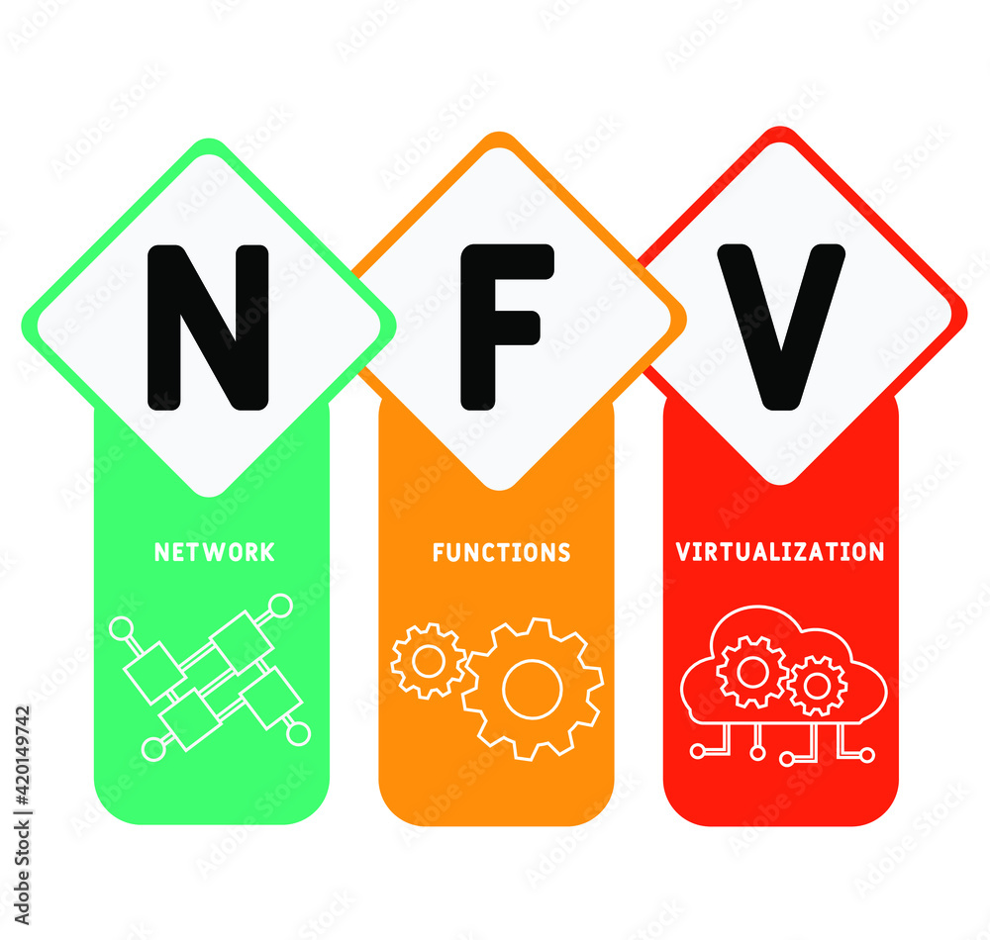
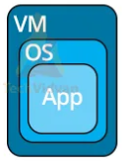
PDS
Computer Vision
Kubernetes_Container and
Analogy
https://github.com/siagianp
https://www.youtube.com/@AmelOline/videos
Open TofU-IaC
https://github.com/amelcharolinesgn2/IoT_simulator-mqtt-NodeRed
https://github.com/amelcharolinesgn2/Cloud-Infrastructures
Notes:
Lab https://dockerlabs.collabnix.com//beginners/dockerfile/lab4_dockerfile_copy.html
https://dockerlabs.collabnix.com/?_gl=1*xgt5mz*_ga*MTk0NzgyNDQ5OC4xNzU2Mjg2NDY5*_ga_2YBFHJ8C2X*czE3NTYzNjY4ODIkbzIkZzAkdDE3NTYzNjY4ODIkajYwJGwwJGgw
https://roadmap.sh/aws
https://roadmap.sh/aws
https://aws.amazon.com/what-is-cloud-computing/
https://www.ibm.com/think/topics/cloud-computing
3. https://www.ibm.com/topics/cloud-computing
4. https://csrc.nist.gov/pubs/sp/800/145/final
https://csrc.nist.gov/pubs/sp/800/145/final
https://docs.openstack.org/liberty/install-guide-rdo/overview.html

Slide 2
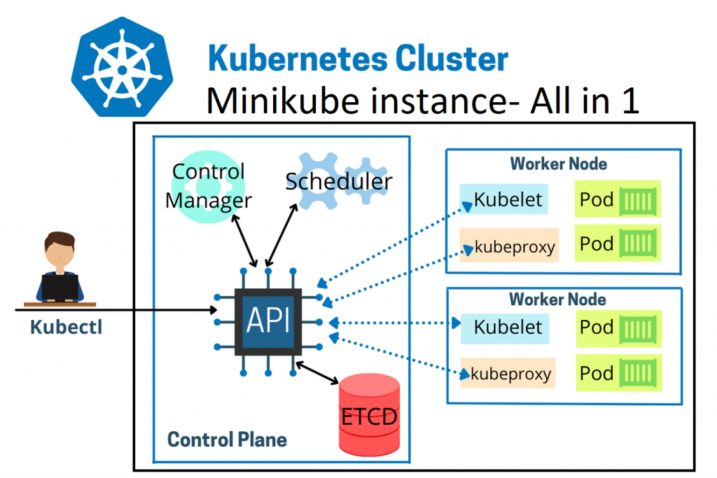
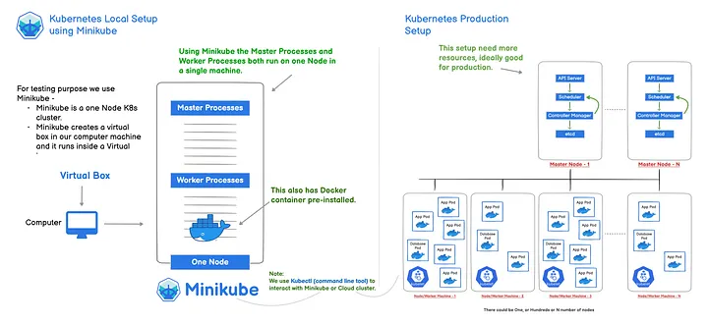
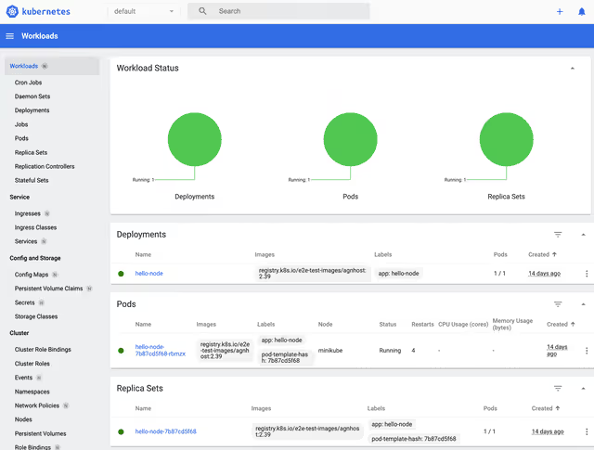
Minikube Oshestration
Notes:
https://www.juniper.net/assets/us/en/local/pdf/nxtwork/cloud-containers-and-microservices-with-contrail.pdf
Cluster Architecture https://kubernetes.io/docs/concepts/architecture/
https://aws.plainenglish.io/kubernetes-local-setup-using-minikube-and-kubectl-3-a46b7effe693
https://www.signadot.com/blog/beginner-minikube-guide

Slide 3
Let’s start with an analogy..

Slide 4

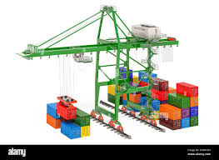
A Cargo Ship…
Carries containers across the sea

Slide 5
A Cargo Ship…
Host Application as Containers ~ Worker Nodes

Slide 6
Container
Worker Node-1

Slide 7
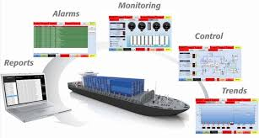
Control Ships..
Managing & Monitoring of the cargo ships

Slide 8
Control Ships..
Manage, Plan, Schedule, Monitor ~ Master

Slide 9
Master
Worker Node-1

Slide 10
Let’s talk about Master Components..

Slide 11
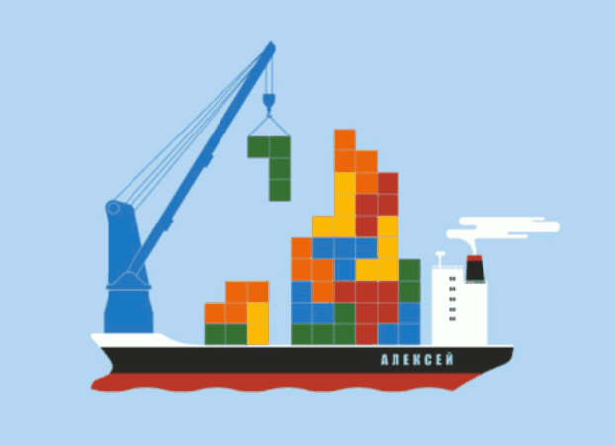
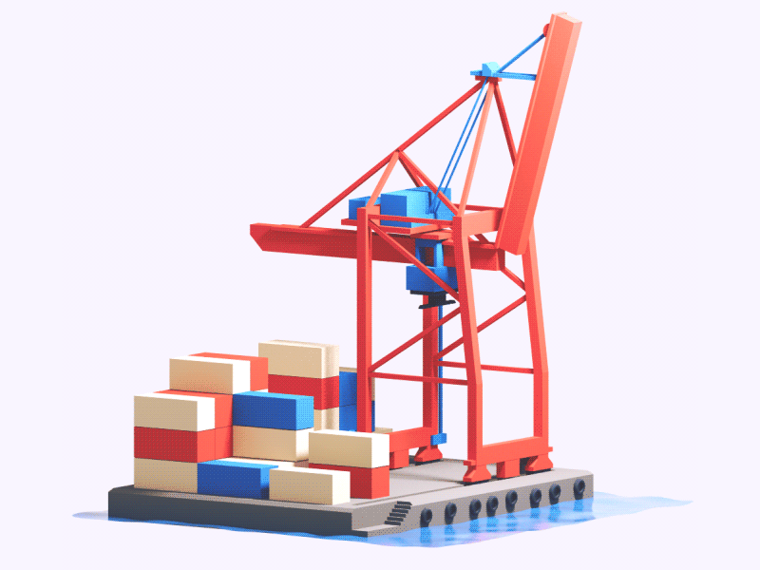
Ship Cranes
Identifies the placement of containers

Slide 12
Ship Cranes
Identifies the right node to place a containers ~ Kube-Scheduler

Slide 13
Scheduler
Master
Worker Node-1

Slide 14


Cargo Ship Profiles
HA database ~ Which containers on which ships? When was it loaded?

Slide 15
Cargo Ship Profiles
HA database ~ Which containers on which ships? When was it loaded? ~ The ETCD Cluster

Slide 16
Scheduler
ETCD
Master
Worker Node-1

Slide 17
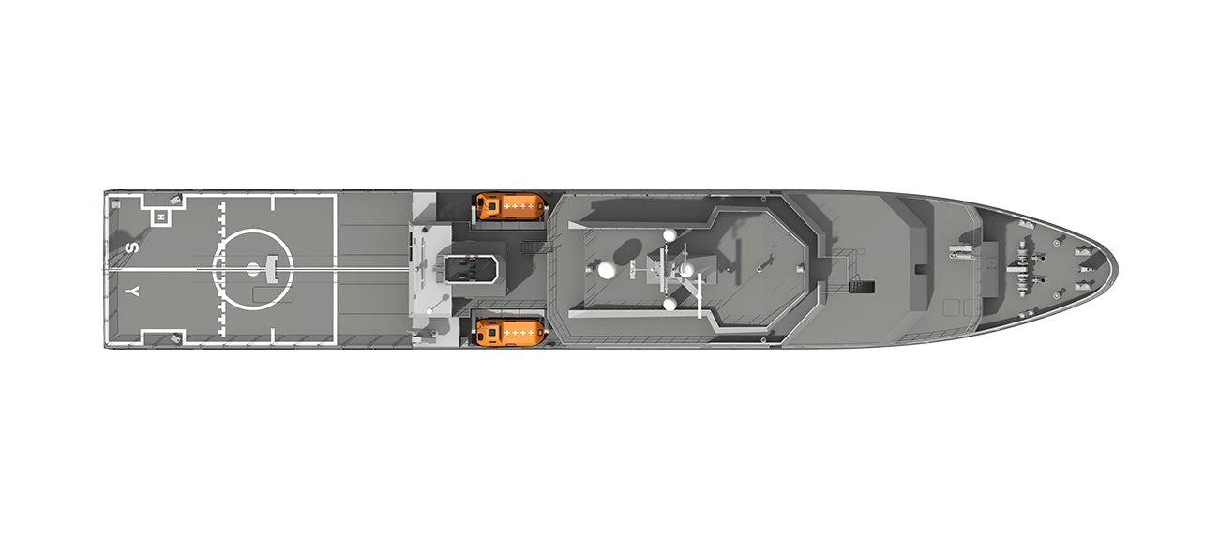
Offices in Dock
Operation Team Office ~ Ship Handling, Control
Cargo Team Office ~ verify if containers are damaged, ensure that new containers are rebuilt
IT & Communication Office – Communication in between various ships

Slide 18


Controllers
Node Controllers – Takes care of Nodes | Responsible for onboarding new nodes in a cluster | Availability of Nodes
Replicas Controller – Ensures that desired number of containers are running at all times
Controller Manager - Manages all these controllers in place

Slide 19
Scheduler
Controller Manager
ETCD
Master
Worker Node-1

Slide 20
How does each of these services communicate with each other?

Slide 21
Kube API Server
A primary management component of k8s
Responsible for orchestrating all operations within a cluster
Exposes K8s API ,used by external users to perform management operation in the cluster and number of controller to monitor the state of the cluster
API Server

Slide 22
kubectl
Scheduler
API Server
API
UI
Controller Manager
ETCD
Master
Worker Nodes

Slide 23
In nutshell…
$kubectl get componentstatus
[node1 install]$ kubectl get nodes -o wide
NAME STATUS ROLES AGE VERSION INTERNAL-IP
EXTERNAL-IP OS-IMAGE
KERNEL-VERSION
CONTAINER-RUNTIME
node1 node2 node3 node4
Ready Ready NotReady NotReady
master
<none>
<none>
<none>
92s v1.14.2
57s v1.14.2
39s v1.14.2
32s v1.14.2
192.168.0.18 <none>
192.168.0.17 <none>
192.168.0.16 <none>
192.168.0.15 <none>
CentOS Linux 7 (Core) CentOS Linux 7 (Core) CentOS Linux 7 (Core) CentOS Linux 7 (Core)
4.4.0-141-generic 4.4.0-141-generic 4.4.0-141-generic 4.4.0-141-generic
docker://18.9.6 docker://18.9.6 docker://18.9.6 docker://18.9.6
[node1 install]$ kubectl get componentstatus
NAME
scheduler controller-manager etcd-0
STATUS MESSAGE
ERROR
Healthy Healthy Healthy
ok ok
{"health":"true"}

Slide 24
Let’s talk about Worker Components..

Slide 25
kubectl
Scheduler
API Server
API
UI
Controller Manager
ETCD
Master
A Worker Node

Slide 26

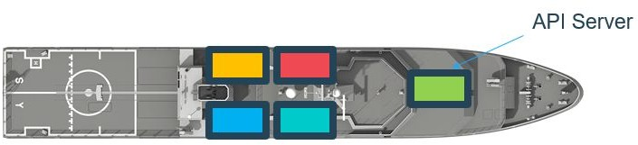
Captain of the Ship
Manages all sort of activity on the ship
Let master ship knows they are interested to join
Sending reports back to master about the status of the ship
Sending reports about the status of the containers

Slide 27
Captain of the Ship ~ Kubelet
Agent which runs on each nodes of the container

Slide 28
kubectl
Kubelet
Scheduler
API Server
API
UI
Controller Manager
ETCD
Worker Node-1
Master

Slide 29
Communication between Cargo Ships
How does two cargo ships communicate with each other?

Slide 30
Kube-proxy Service
How will web server running on one worker node reach out to DB server on another worker node?
Communication between worker nodes
Kube-proxy

Slide 31
Internet
Kubelet
Kube-proxy
Scheduler
API Server
Controller Manager
ETCD
Master
Worker Node-1

Slide 32
Let’s talk about Pods..

Slide 33
Internet
Master
Kubelet
Kube-proxy
Scheduler
API Server
Pod
Controller Manager
ETCD
Master
Worker Node-1

Slide 34
Internet
Kubelet
Kube-proxy
Scheduler
API Server
Pod
Controller Manager
ETCD
Container
Worker Node-1
Master

Slide 35
Docker Containers
A popular Container Runtime

Slide 36
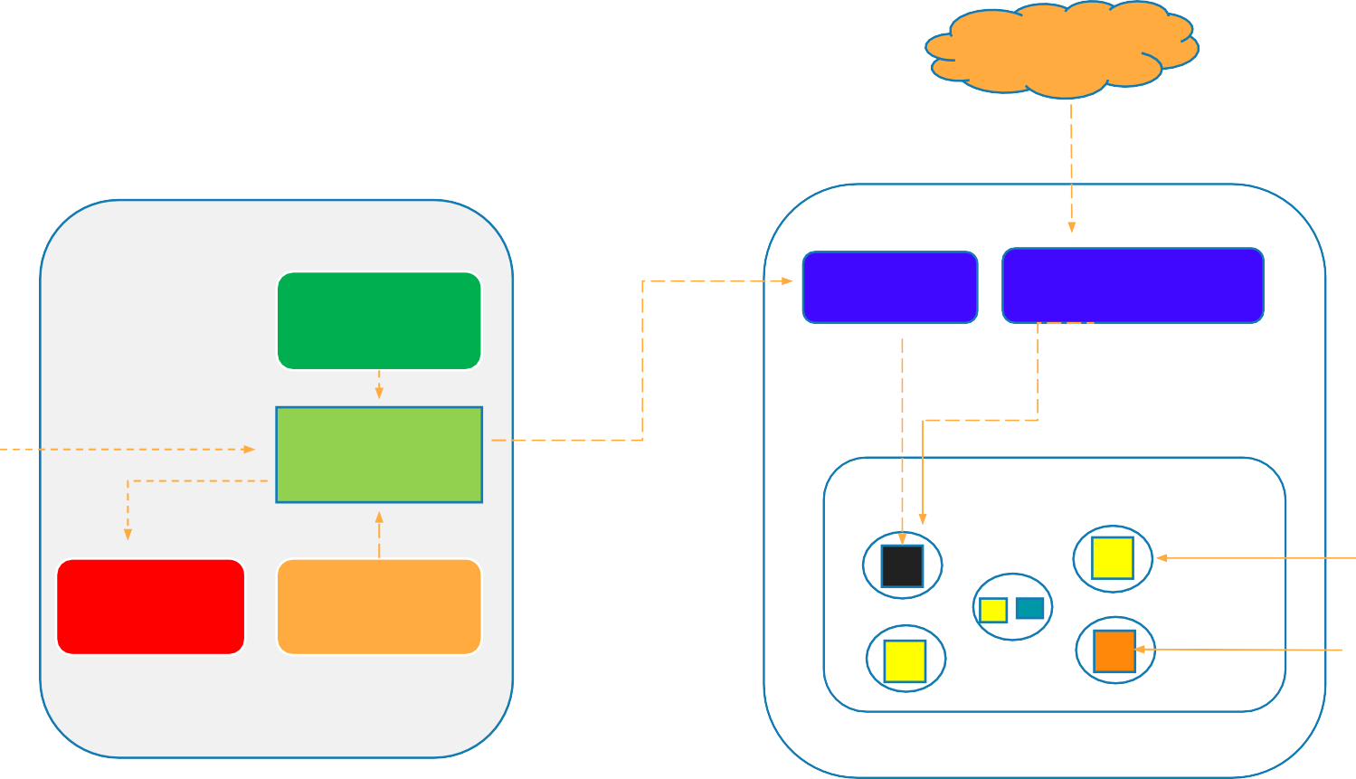
Overall Kubernetes Architecture
Internet
kubectl
Kubelet
Kube-proxy
Scheduler
API
API Server
Pod
UI
Controller Manager
ETCD
Container
Master
Worker Node

Slide 37
Config
Setting up a single Node K8s cluster on Docker Desktop for Windows
Setting up 5 Node Kubernetes Cluster on PWK
Setting up 3 Nodes K8s Cluster on Bare Metal or VM

Slide 38
Let’s Deep Dive into Pods…

Slide 39
Pod - Concepts
What is Pod?
Pod Deployment
Multi-Container
Pod Networking
Inter-Pod & Intra-Pod Networking
Pod Lifecycle
Pod Manifest File

Slide 40
Atomic Unit of Scheduling
Virtualization
Docker
Kubernetes
VM
Pod
Container

Slide 41

How Pods are deployed?
Scheduler
API Server
Pod
Container
Master
Cluster

Slide 42
Scaling the Pods to accommodate increasing traffic
Scheduler
API Server
Pod
Container
Master
Worker Node

Slide 43
What if node resources is getting insufficient?
Scheduler
API Server
Pod
Container
Master
Worker Node

Slide 44
What if node resources is getting insufficient?
Worker-2
Scheduler
API Server
Worker-1
Pod
Container
Master
Cluster

Slide 45
What if node resources is getting insufficient?
Worker-2
Scheduler
API Server
Worker-1
Pod
Container
Master
Cluster

Slide 46
2 Containers in a same Pod
Worker-2
Scheduler
API Server
Worker-1
Pod
Container
Master
Cluster

Slide 47
Pod Networking
Pod 1
Pod 2
Main Controller
Supporting Controller
Supporting Controller
:8080
:3000
:7777
10.0.30.50
10.0.30.60

Slide 48
How does these containers inside Pods communicate with External World?

Slide 49
Network Namespace
Pod 1
Pod 2
Main Controller
Supporting Controller
Supporting Controller
:8080
:3000
:7777
10.0.30.50
10.0.30.60
10.0.30.50:8080
10.0.30.50:3000
50

Slide 50
How does one Pod talk to another Pod?
Welcome to Inter-Pod Communication..

Slide 51
Pod Networking
Pod 1
Pod 2
Main Controller
Supporting Controller
Supporting Controller
:8080
:3000
:7777
10.0.30.50
10.0.30.60
Pod Network
52

Slide 52
How does Intra-Pod communication take place?

Slide 53
Intra-Pod Communication
Pod 1
Supporting Container
Main Container
:8080
:3000
Localhost
10.0.30.50
:8080 :3000

Slide 54
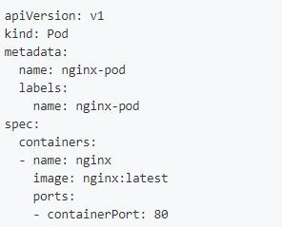
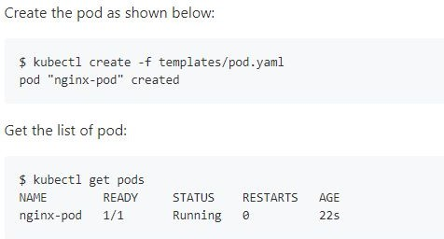
A Look at Pod Manifest

Slide 55
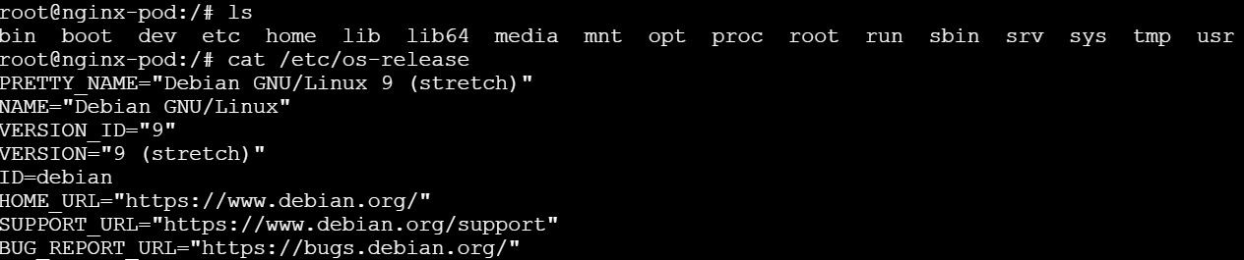
Get a shell to a running Container
Verifying the Operating System

Slide 56
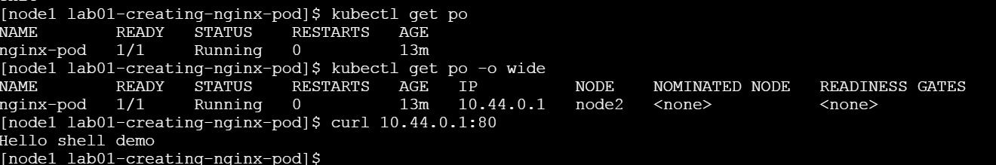
Get a shell to a running Container
root@nginx-pod:/# echo Hello shell demo > /usr/share/nginx/html/index.html
Verifying the index page

Slide 57
Stages of Life Cycle of Pod

Slide 58


Lifecycle of a Pod
Pod
Pod
Pod
Manifest
API Server
Pending
Running
Succeeding
Pod
Failed

Slide 59
How can you ensure that there are 3 Pods instances which are always available and running at point in time?
ReplicaSet

Slide 60
What is ReplicaSet all about?
Maintain a stable set of replica Pods running at any given time
Ensures that a specified number of Pods are running at any time
If there are access Pods, they get killed and vice versa
New Pods are launched when they get failed, get deleted and terminated
ReplicaSet & Pods are associated with “labels”

Slide 61
Replication Controller Vs ReplicaSets
ReplicaSet is the next generation of Replication Controller
Both serve the same purpose
ReplicaSet
Replication Controller
Set-based Selectors
Equality-based Selectors

Slide 62
Labels & Selectors
When Pods are scaled, how are these Pods Managed at such large scale?
Pods
Controllers & Services
Labels
#Pod-Spec apiVersion: v1 kind: pod metadata:
name: nginx-Pod
labels:
app: guestbook tier: frontend env: dev
spec:
replicas: 5..
Selectors

Slide 63
Equality-based Selectors
Set-based Selectors
Operators:
Operators:
= and ==
in notin exists
Examples:
Examples:
environment = production tier! = frontend
environment in (production, qa) tier notin(frontend, backend)
Commandline:
Commandline:
$kubectl get pods -l environment=production
$kubectl get pods -l `enviornment in(production)
In Manifest:
In Manifest:
..
selector:
environment: production tier: frontend
..
Supports: Services, Replication Controller
..
selector:
matchExpressions:
{key:environment,operator:in,values:[prod,qa]}
{key:tier,operator:Notin,values:[frontend,backend]}
..
Supports: Job, Deployment, ReplicaSet, DaemonSet

Slide 64
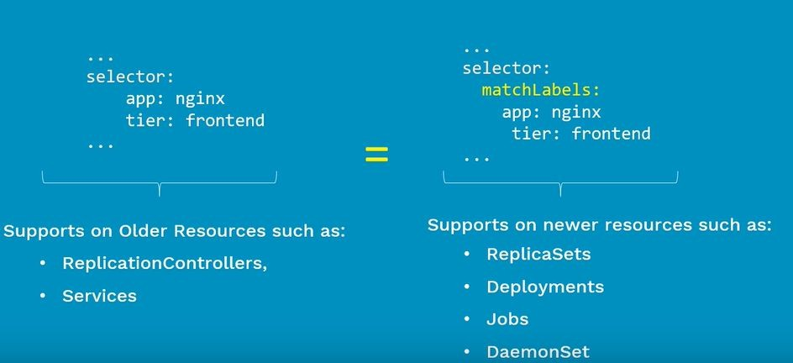

Slide 65
Ex: ReplicaSet
Manifest file
Deploy app using RS Display and validate RS
Test – Node Fails
Test – Scale Up
Test – Scale Down

Slide 66
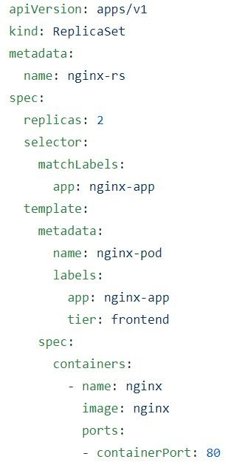
ReplicaSet Manifest File

Slide 67
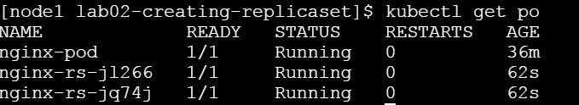
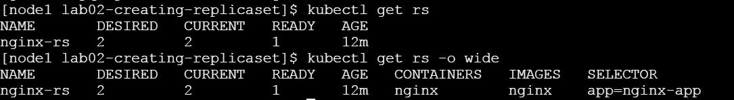
Creating Nginx-rs Pods
$kubectl create –f nginx-rs.yaml

Slide 68
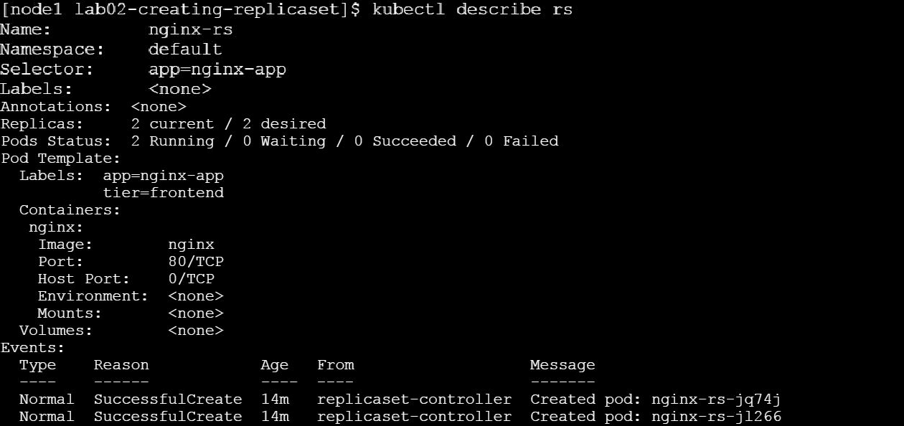

Slide 69
Scaling the Nginx Service

Slide 70
Deployment

Slide 71
Deployment
A Deployment controller provides declarative updates for Pods and ReplicaSets.
You describe a desired state in a Deployment, and the Deployment controller changes the actual state to the desired state at a controlled rate. You can define Deployments to create new ReplicaSets, or to remove existing Deployments and adopt all their resources with new Deployments.
How is it different from Replicaset?
ReplicaSet doesn’t provide features like updates & roll backs.

Slide 72
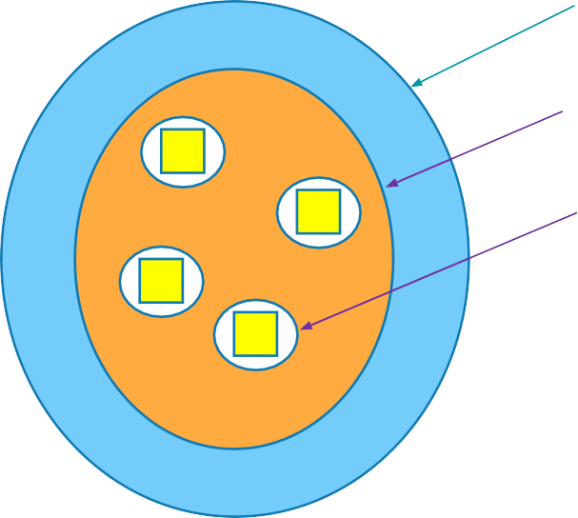
A Single Deployment Manifest File
Deployment
ReplicaSet
Do we need to create 3 different manifest files for each on these?
Pods
Answer is “No”. We can create all 3 different objects using a single Deployment manifest file

Slide 73
Features of Deployment
Multiple Replicas
Upgrade
Rollback
Scale Up or Down
Pause & Resume
74

Slide 74
Deployment Types - Recreate
Recreate
How it works?
Shutting down version A and then making sure, version A is turned off... then bringing up version B.
Demerits:
During this, there will be a downtime of the service. Easy to setup.
Blue/Green

Slide 75
Deployment Type – Rolling Updates
RollingUpdate(Ramped or Incremental)
Default updating strategy in Kubernetes.
It can take sometime for a complete update process
How it works?
Slowly rollout a version of app by replacing instances one after the other until all the instances are successfully rolled out.
Assume that there are 10 instances of version A which is running behind the LB. Then update strategy starts with one instance of version B is deployed When version B is ready to accept traffic, one instance of version A is removed from the pool

Slide 76
Deployment Type - Canary
Canary
- Ideal deployment method for someone who want to test newer version before it is deployed 100%.
How it works?
This method is all about gradually shifting production traffic from version A to version B.
Lets imagine that there are about 10 instances of app version A running inside a cluster. You use Canary deployment when you dont want to upgrade all of your instances. Let's say you upgraded your 2 instances of ver A to version B then do some testing. If test results are good, then you upgrade remaining 8 instances to version B. Say, your version B is ready, then you completely shut down version A.

Slide 77
Deployment Type – Blue Green
Blue Green
- Instance roll out and roll back.
How it works?
Using this method, version B(which is GREEN) is deployed along side version A(which is BLUE) with exactly same amount of instances.
After testing new version with all the requirement, the traffic is switched from version A to version B at the LB
level.

Slide 78
Demo - Deployment
Manifest file
Deploy app using RS
Display and validate RS
Test – Node Fails
Test – Scale Up
Test – Scale Down

Slide 79
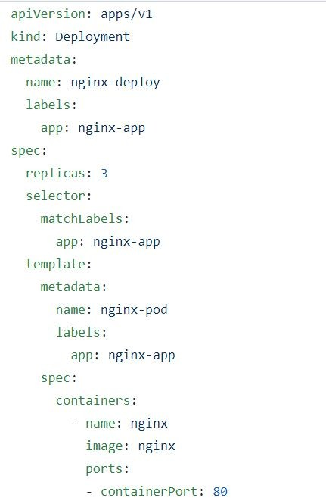
Deployment Manifest File
ReplicaSet
Pods

Slide 80
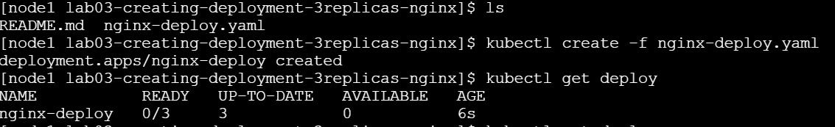
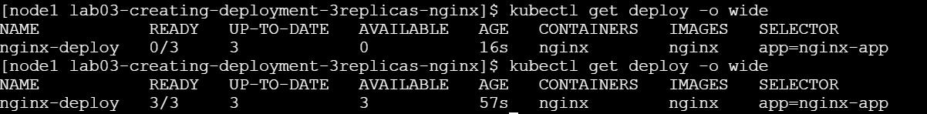
Deployment

Slide 81
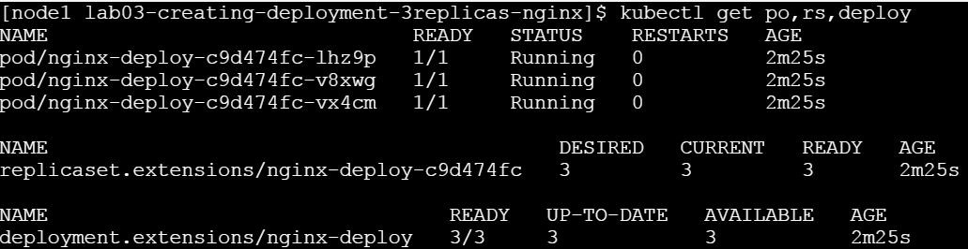
Deployment => Pods + ReplicaSet
Deployment
ReplicaSet
Pods

Slide 82
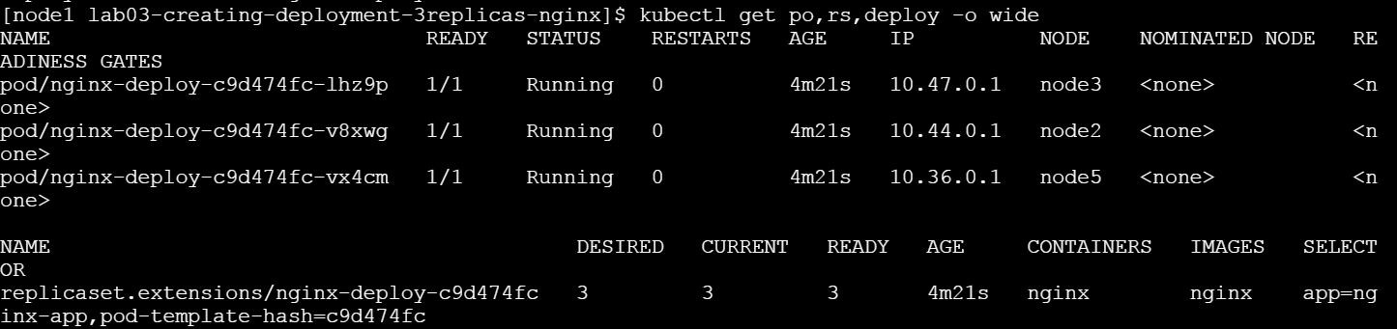
3 Instances of same Nginx Apps running in the form of Pods

Slide 83
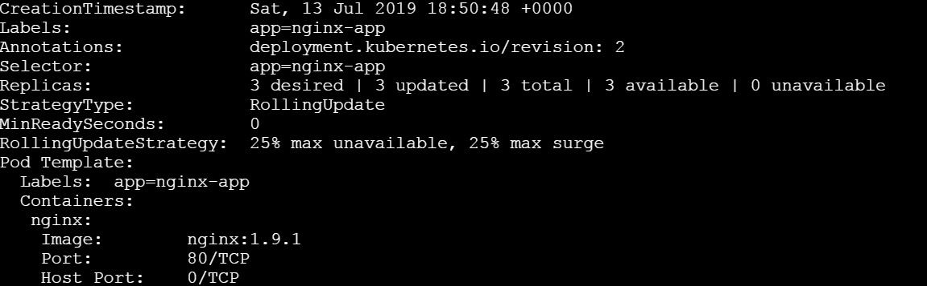
3 Instances of same Nginx Apps running in
the form of Pods
Update Deployment

Slide 84
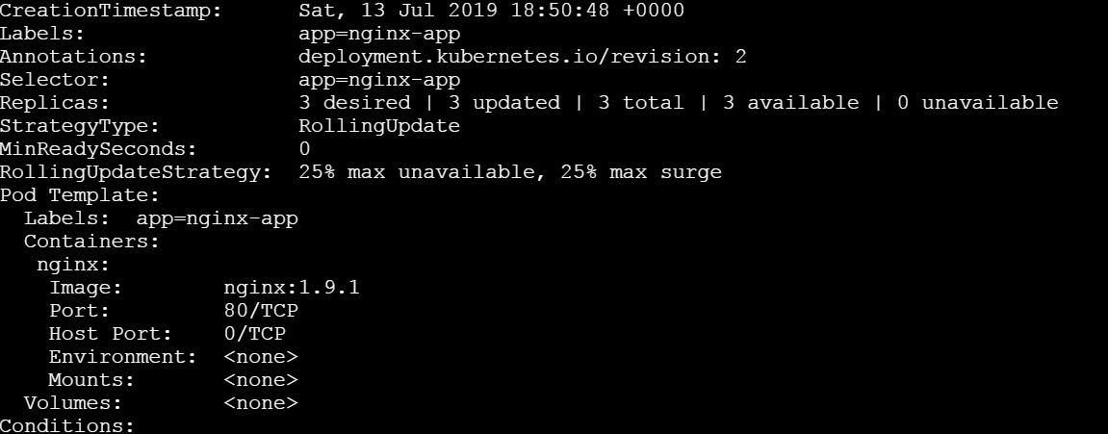
3 Instances of same Nginx Apps running in the form of Pods

Slide 85
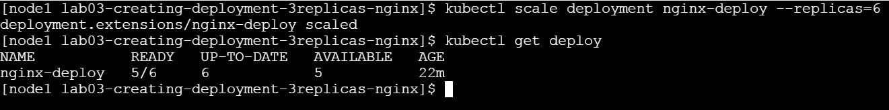
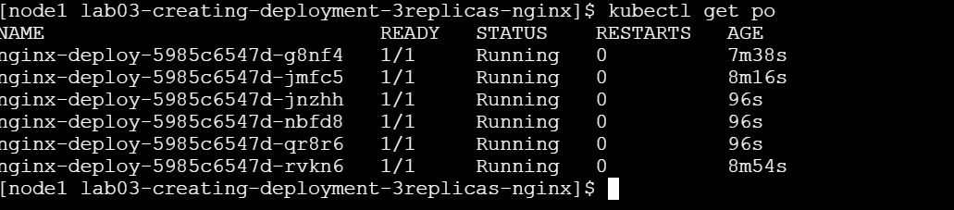
Scaling up

Slide 86
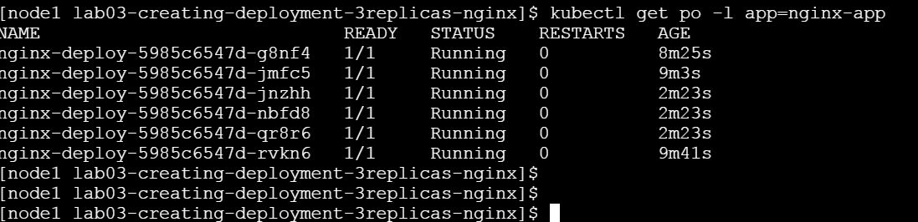
Listing Pods by Labels

Slide 87
Services

Slide 88
Services
Imagine that, you have been asked to deploy web app
How does this frontend web app exposed to outside world?
How do front end app connected to backend database?
How do we resolve Pod IP changes, when they die?

Slide 89
Scopes
Why do we need services?
What is Service?
Type of Services

Slide 90
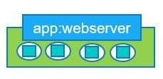


Services
User
192.168.1.1
Frontend Service:
Service(frontend)
A Service which stays between user and frontend pod
Frontend Pod
Backend Service:
Service(backend)
A Service which communicate between frontend Pod and backend end
app:db
Backend Pod
Node

Slide 91
Types of Services
LoadBalancer
ClusterIP
Node-1
NodePort
Node-1
Reachable within the cluster.
Connects Frontend Pods to Backend Pods
- Exposing Frontend app to external world
Node-1
Node-1
Node-1
- Equally distribute the loads

Slide 92
Services: ClusterIP

Slide 93
Services
Imagine you need to deploy one full fledge app which consists of frontend app & backend app
How can we restrict access of backend database to only within the kubernetes cluster?

Slide 94
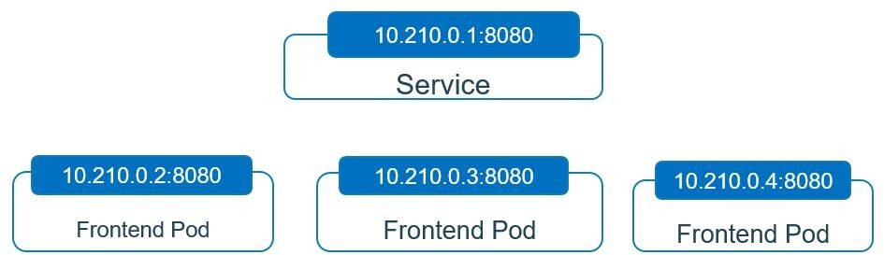
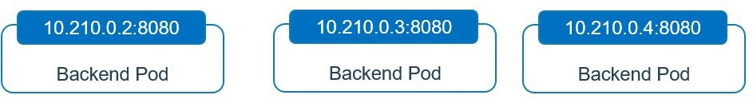
User
192.168.1.1:31000
NodePort
10.210.1.1:8080
Services
ClusterIP

Slide 95
Guestbook
Frontend Web app
Backend DB - Redis

Slide 97
Thank you.
Q&A

Slide 98
The End

Slide 99


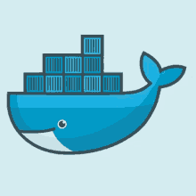

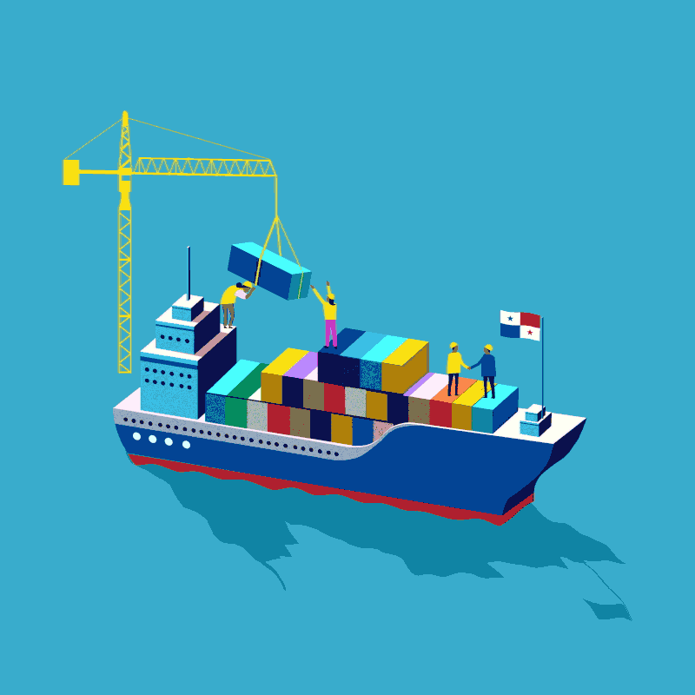


Minikube Oshestration (Con’t)
Scheluler
Worker Node-1
Let’s Start with an Analogy
Master
A Cargo Ship ~ Carries containers across the sea
A Control Ships
Managing & Monitoring of the cargo ships
Manage, Plan, Schedule, Monitor ~ Master
Worker Node-N
A Cargo Ships Profiles
HA database ~ Which containers on which ships? When was it loaded?
HA database ~ Which containers on which ships? When was it loaded? ~ The ETCD Cluster
Scheluler
Worker Node-1
A Cargo Ship.. Host Application as Containers ~ Worker Nodes
Container/Nodes/Pods
ETCD
Worker Node-1
Worker Node-N
Master/Docker
A Control ManagerNode Controllers – Takes care of Nodes | Responsible for onboarding new nodes in a cluster | Availability of Nodes - Replicas Controller – Ensures that desired number of containers are running at all times - Controller Manager - Manages all these controllers in place
Worker Node-N
Controller Manager

Slide 100
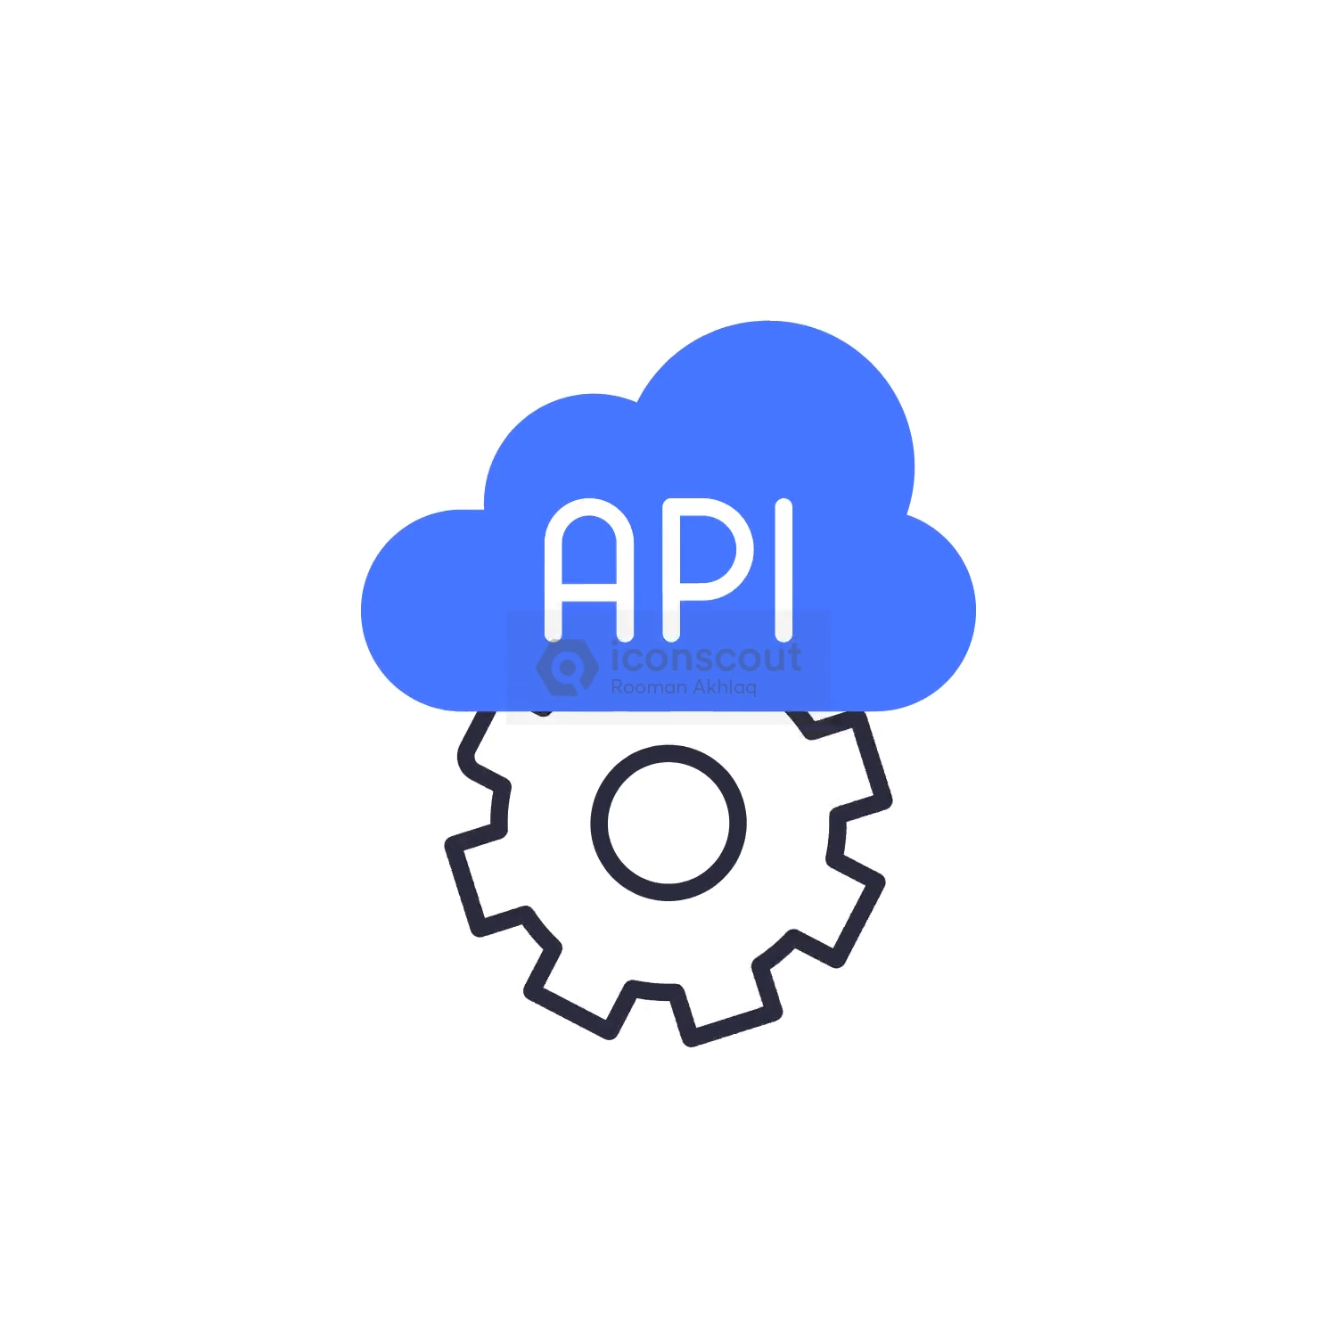
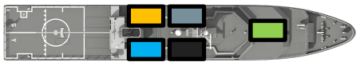


Minikube Oshestration (Con’t)
Let’s Start with an Analogy
Scheluler
Worker Node-1
Scheluler
Worker Node-1
Controller Manager
Controller Manager
Worker Node-2
ETCD
ETCD
Worker Node-N
Worker Node-N
Control Plane
Control Plane
Master
Worker NodeS
Master
Worker NodeS
How does each of these services communicate with each other?
Scheluler
Kube API Server
kubectl
Worker Node-1
API Server
Kube API Server
- A primary management component of k8s
- Responsible for orchestrating all operations within a cluster
- Exposes K8s API ,used by external users to perform management operation in the cluster and number of controller to monitor the state of the cluster
UI
ETCD
Controller Manager
Worker Node-N
Control Plane
Master
Worker NodeS
Notes:
https://collabnix.com/wp-content/uploads/2022/02/Understand-Kubernetes-in-100-slides.pdf

Slide 101
In nutshell…
[node1 install]$ kubectl get nodes -o wide
NAME STATUS ROLES AGE VERSION INTERNAL-IP EXTERNAL-IP OS-IMAGE KERNEL-VERSION CONTAINER-RUNTIME
node1 Ready master 92s v1.14.2 192.168.0.18 <none> CentOS Linux 7 (Core) 4.4.0-141-generic docker://18.9.6
node2 Ready <none> 57s v1.14.2 192.168.0.17 <none> CentOS Linux 7 (Core) 4.4.0-141-generic docker://18.9.6
node3 NotReady <none> 39s v1.14.2 192.168.0.16 <none> CentOS Linux 7 (Core) 4.4.0-141-generic docker://18.9.6
node4 NotReady <none> 32s v1.14.2 192.168.0.15 <none> CentOS Linux 7 (Core) 4.4.0-141-generic docker://18.9.6
Kubernetes Components
[node1 install]$ kubectl get componentstatus
NAME STATUS MESSAGE ERROR
scheduler Healthy ok
controller-manager Healthy ok
etcd-0 Healthy {"health":"true"}
kubectl [command] [TYPE] [NAME] [flags]
$kubectl get componentstatus
[node1 install]$ kubectl get nodes -o wide
When you finish using the debugging Pod, delete it:
kubectl get pods
NAME READY STATUS RESTARTS AGE
node-debugger-mynode-pdx84 0/1 Completed 0 8m1s
# Change the pod name accordingly
kubectl delete pod node-debugger-mynode-pdx84 –now
pod "node-debugger-mynode-pdx84" deleted
Notes:
https://kubernetes.io/docs/reference/kubernetes-api/cluster-resources/component-status-v1/

Slide 102
Scheluler
kubectl
Worker Node-1
Scheluler
kubectl
Kubelet
Kubelet
API Server
API Server
UI
ETCD
Controller Manager
UI
ETCD
Controller Manager
Worker Node-N
Control Plane
Master
Worker NodeS
Control Plane
Master
A Worker Node-1
A Cargo Ship_A
Communication between Cargo Ships
How does two cargo ships communicate with each other?
Captain of the Ship ~ Kubelet
Agent which runs on each nodes of the container
Manages all sort of activity on the ship
Let master ship knows they are interested to join
Sending reports back to master about the status of the ship
Sending reports about the status of the containers
API Server
A Cargo Ship_B
A Cargo Ship_B

Slide 103

Kube-proxy Service
How will web server running on one worker node reach out to DB server on another worker node?
Communication between worker nodes
A Cargo Ship_B
Kube-proxy
Kube-proxy
Internet
Scheluler
kubectl
Kubelet
Kubelet
Kubelet
Kube-proxy
API Server
UI
ETCD
Controller Manager
Control Plane
Master
A Worker Node-1

Slide 104
Let’s talk about Pods..

Slide 105
Pods
Internet
Scheluler
kubectl
Kubelet
Kubelet
Kubelet
Kube-proxy
API Server
UI
ETCD
Controller Manager
Pod
Control Plane
Master
A Worker Node-1
Internet
Scheluler
kubectl
Kubelet
Kubelet
Kubelet
Kube-proxy
API Server
• Setting up a single Node K8s cluster on Docker Desktop for Windows
• Setting up 5 Node Kubernetes Cluster on PWK
• Setting up 3 Nodes K8s Cluster on Bare Metal or VM
UI
ETCD
Controller Manager
Pod
Control Plane
Container
Master
A Worker Node-1

Slide 106
Let’s Deep Drive into Pods…..

Slide 107
POD Concepts:
What is Pod?
Pod Deployment
Multi-Container
Pod Networking
Inter-Pod & Intra-Pod Networking
Pod Lifecycle
Pod Manifest File

Slide 108
Dockerfile
Lab #1: Installing GIT
Lab #2: ADD instruction
Lab #3: COPY instruction
Lab #4: CMD instruction
Lab #5: ENTRYPOINT instruction
Lab #6: WORKDIR instruction
Lab #7: RUN instruction
Lab #8: ARG instruction
Lab #9: EXPOSE instruction
Lab #10: VOLUME instruction
Lab #11: EXPOSE instruction
Lab #12: LABEL instruction
Lab #13: ONBUILD instruction
Lab #14: HEALTHCHECK instruction
Lab #15: SHELL instruction
Lab #16: Entrypoint Vs RUN
Lab #17: USER instruction
Writing Dockerfile with Hello Python Script Added
Let’s proceed:
Lab #1: Create an image with GIT installed
Notes:
https://dockerlabs.collabnix.com/beginners/dockerfile/Writing-dockerfile.html#what-is-a-dockerfile
https://dockerlabs.collabnix.com/

Slide 109
Thank you.
Q&A

